Slide 1
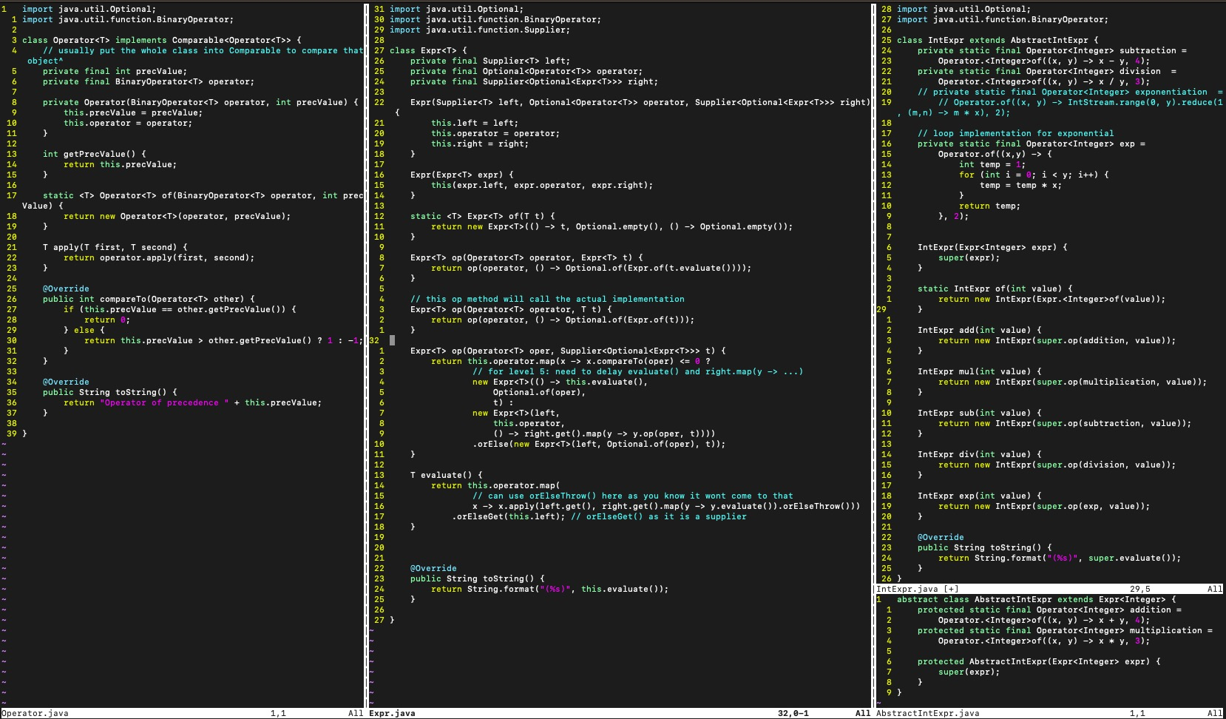
Notes:
Practise Ex 3

Slide 2
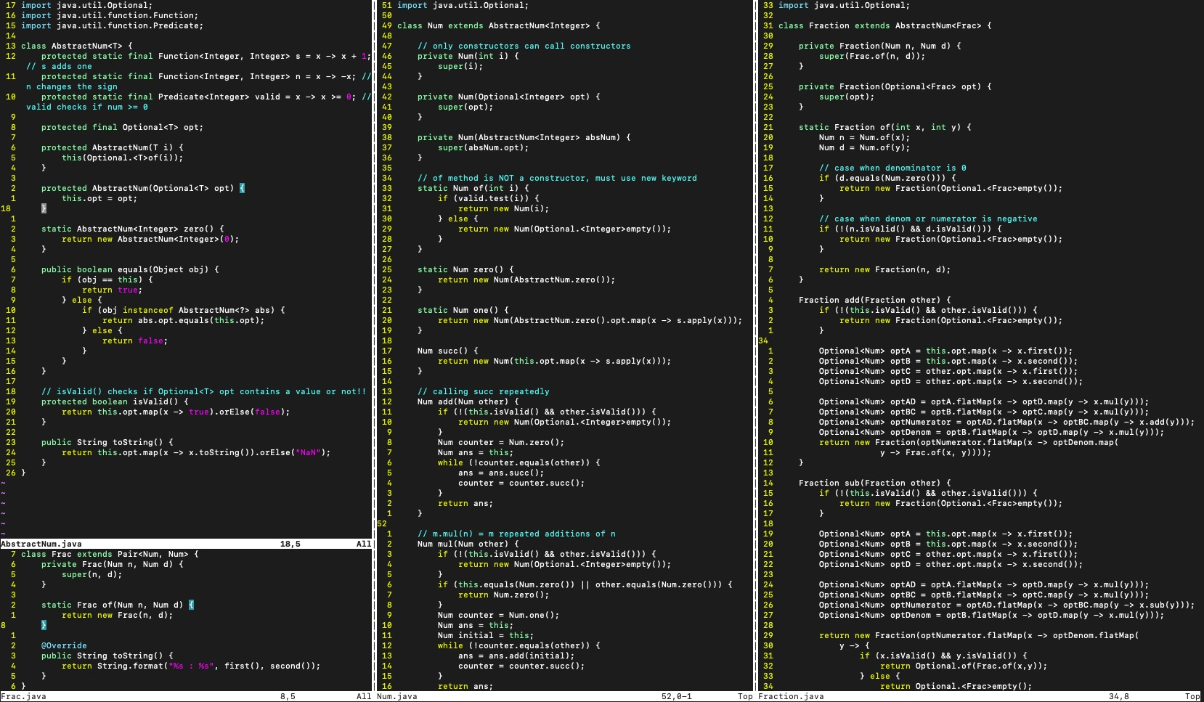
Notes:
Lab 8

Slide 3
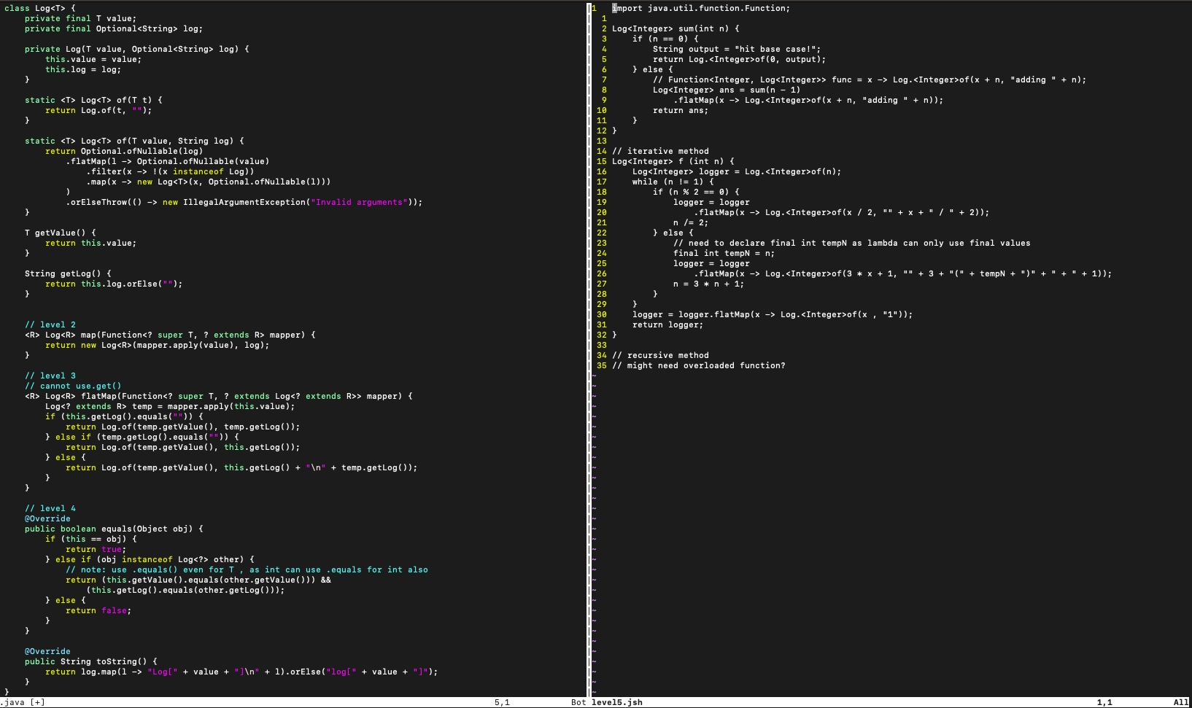
Notes:
Lab 7

Slide 4
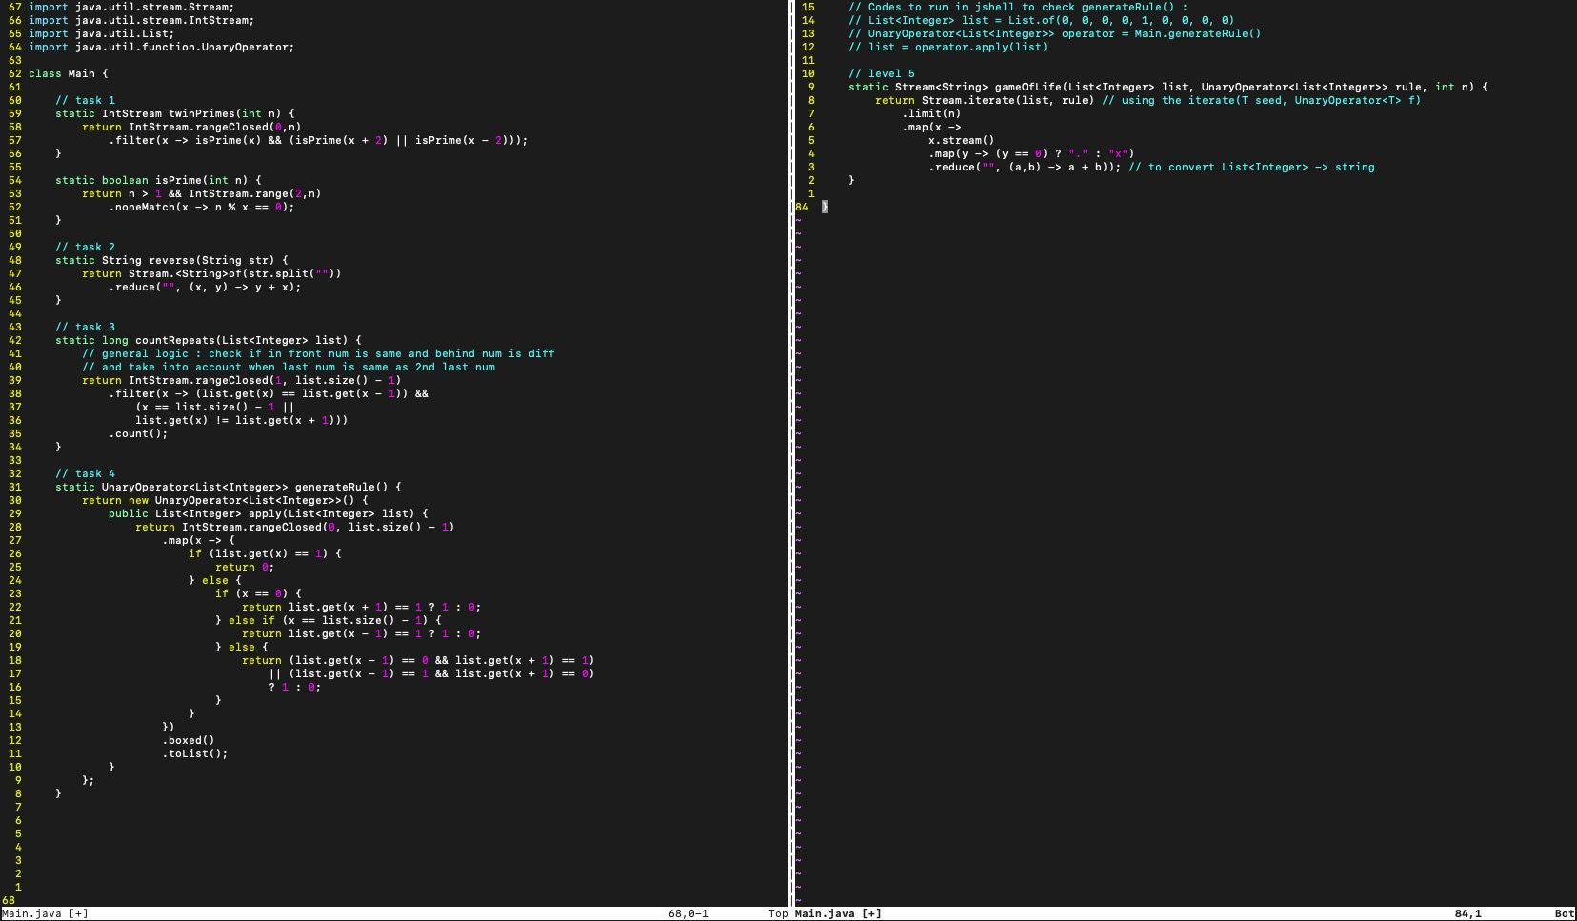
Notes:
Ex 5

Slide 5
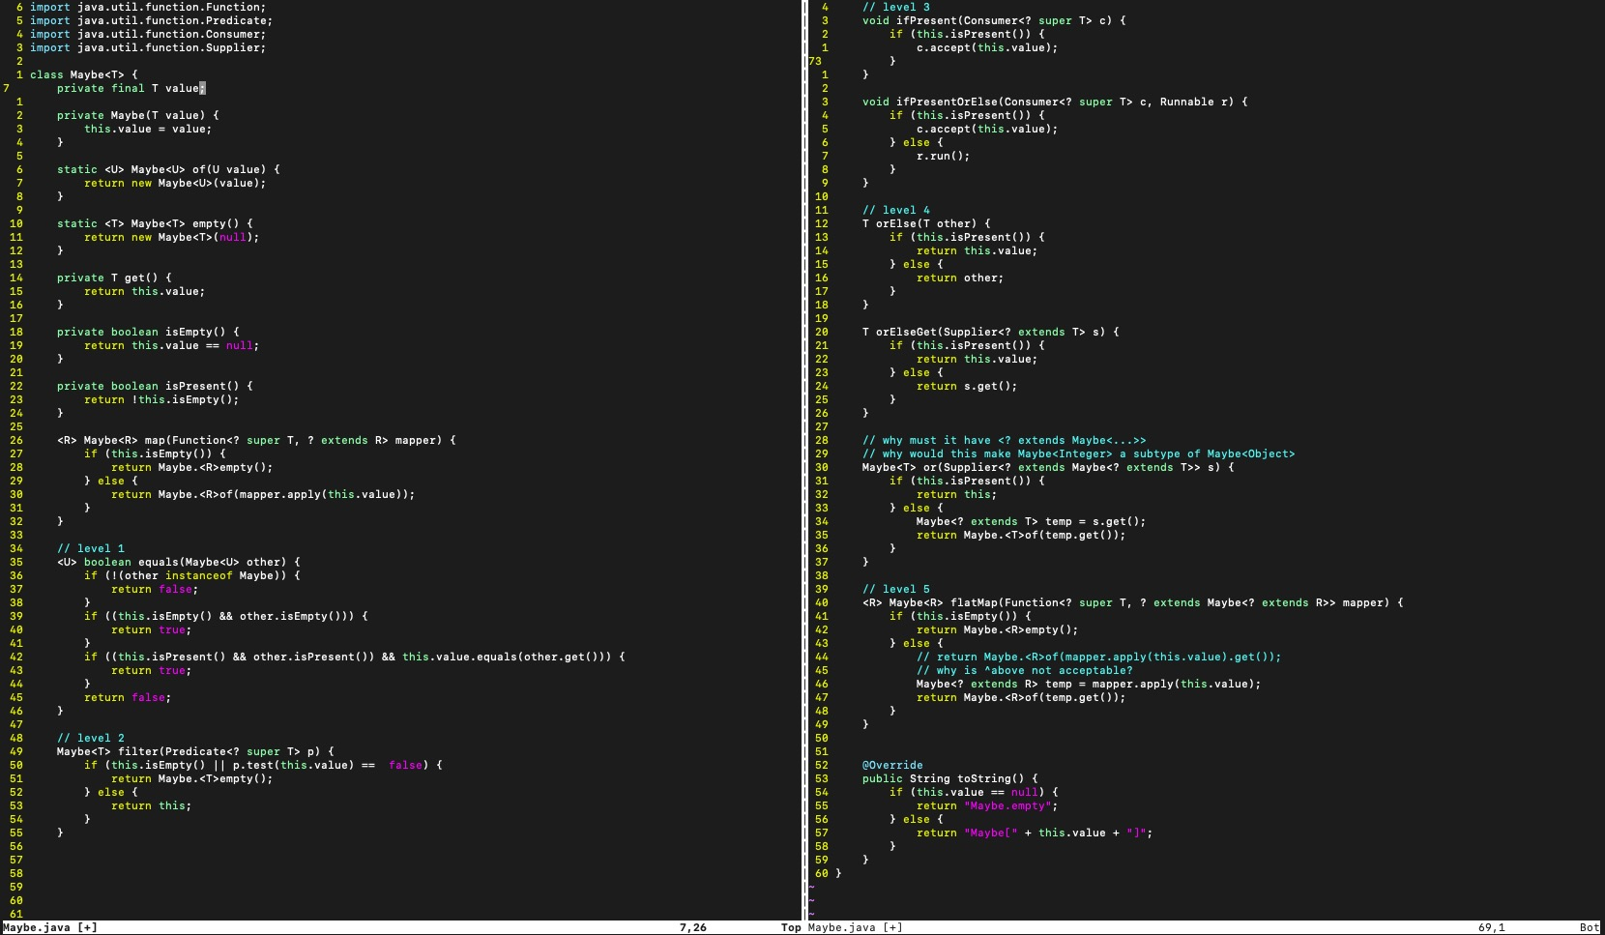
Notes:
Ex 4

